Slide 1
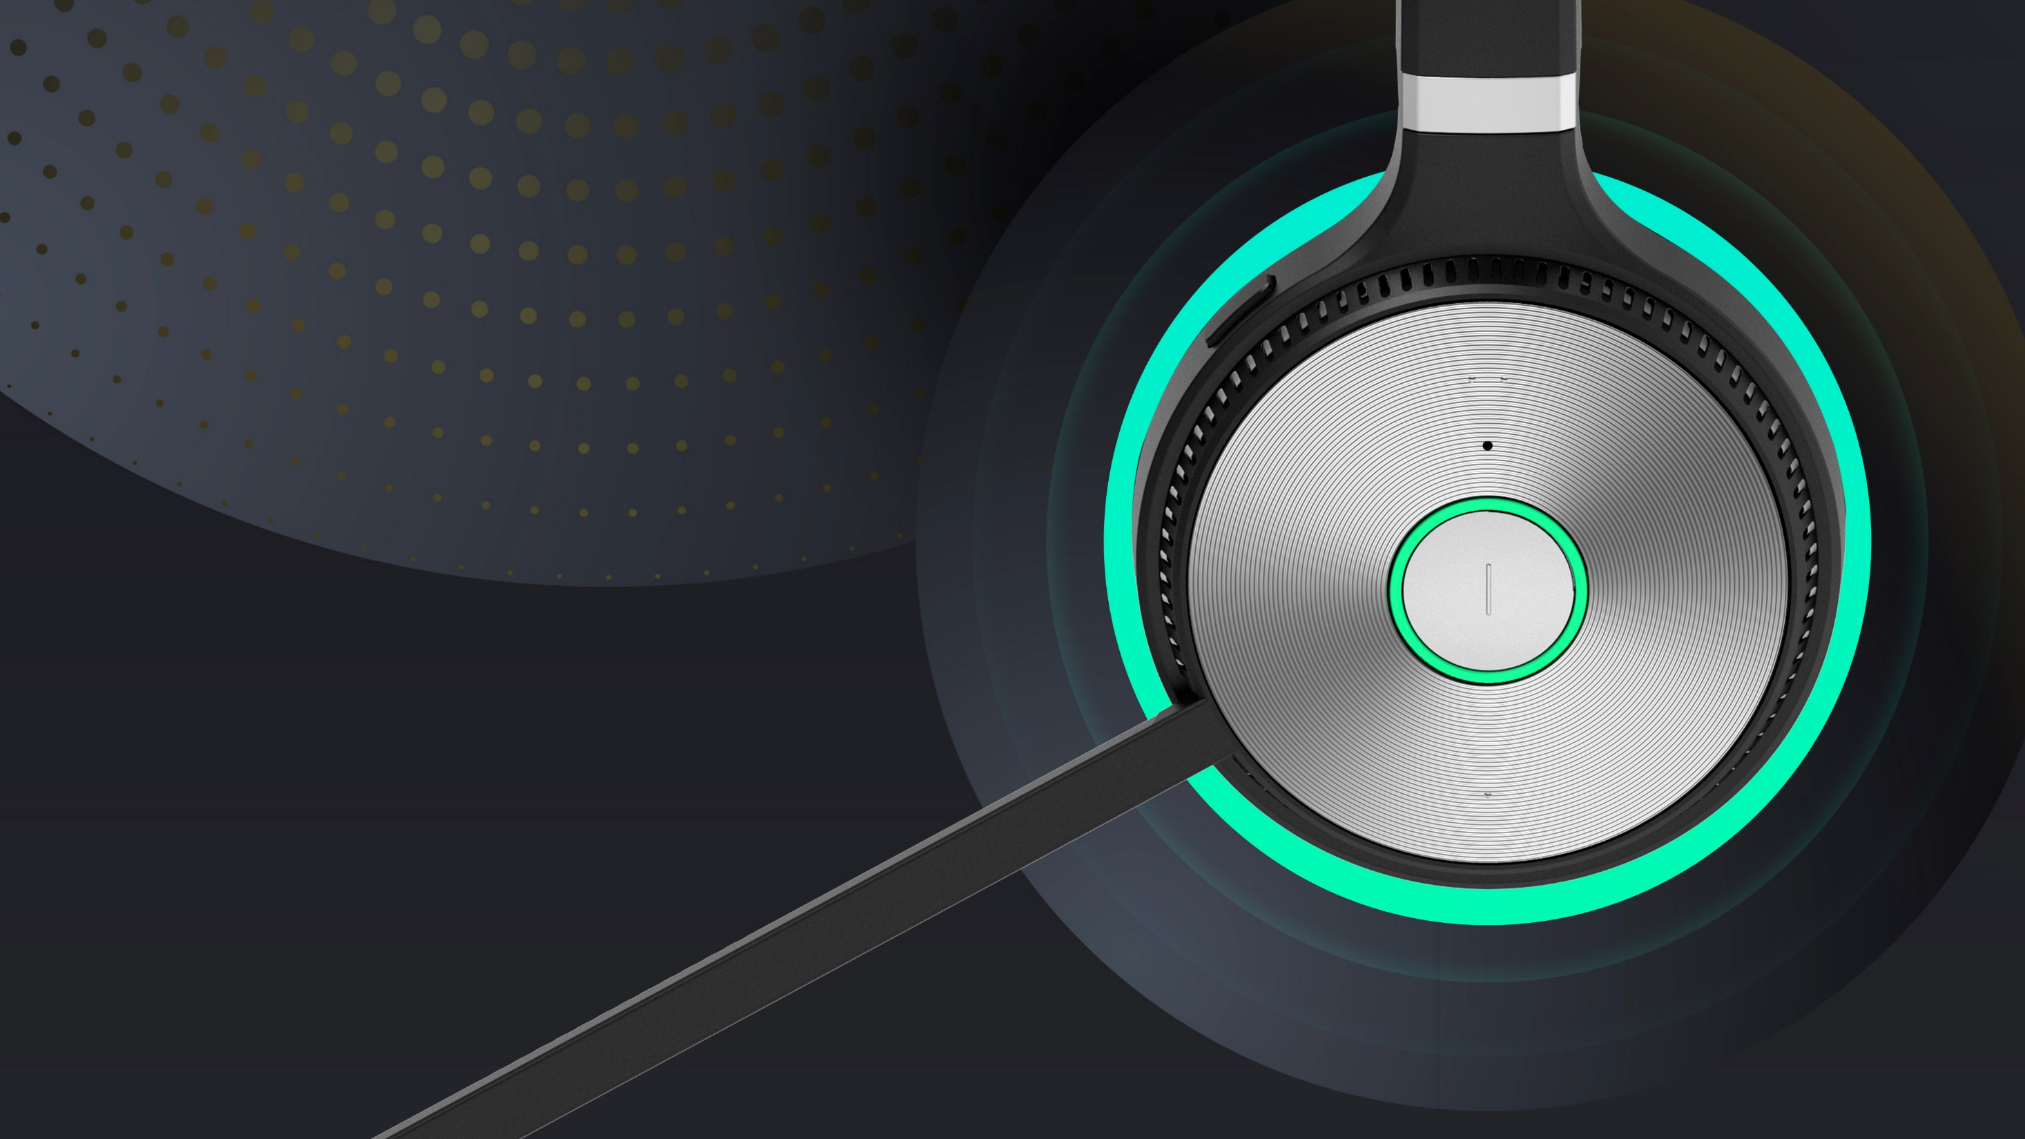
YEALINK
BUSINESS
HEADSETS

Slide 2
Why Yealink Headset

Slide 3
Why Yealink- Global Leading Communication & Collaboration Solutions Provider
No.1 Market Share
by SIP Desktop Phone Unit Shipment
38.4% Compound Growth Rate
Audio and Video | SMB and Enterprise | IP Phone and VCS
Mission
We help our clients make the most of their UC experience and embrace the power of “Easy collaboration, high productivity.”
500,000
Yealink IP Phones serve more than 500,000 companies around the world.
15,000,000
More than 15 million Yealink IP endpoints have been sold globally.
1/500
One in every 500 people on earth owns or is using a Yealink product.

Slide 4
Why Yealink Headsets – Top Strategic Product Line
Yealink’s personal collaboration device business has grown rapidly.
Business Headset is already one of the three strategy product lines in Yealink.
248%
130+%
2019
2020
2021
2022
Headsets are provided as accessories
Entered the headset industry, clarified the strategy headset product line
Release USB wired headset series and RJ headset series
Release DECT wireless headset series
Headset business has grown rapidly
Will release Bluetooth headset series
Have a complete headset product line

Slide 5
Why Yealink Headset – Constant R&D Investment
8+ Years
20+ Years
1/3 Investment
Headset will be the strategic product line in Yealink, there will be 30% of total R&D investment on Headset product line
7+ years experience on wireless technology, 9+ DECT products released.
DECT Wireless Technology
Bluetooth Wireless Technology
20+ years experience on audio communication technology.
Audio Cancelation Technology
Sound Technology
50+ Months
200+ Customers
1000+ Head Styles
40+ months headset market research & analyze, technology development
Supply Chain
Manufacture
Researched 200+ customers in 15+ countries to study and understand all headset requirements
User Experience
Feature Requirement
1000+ head styles globally in database of Yealink to find out the best wearing experience.
Wearing Comfortable
ID Design & Materials

Slide 6
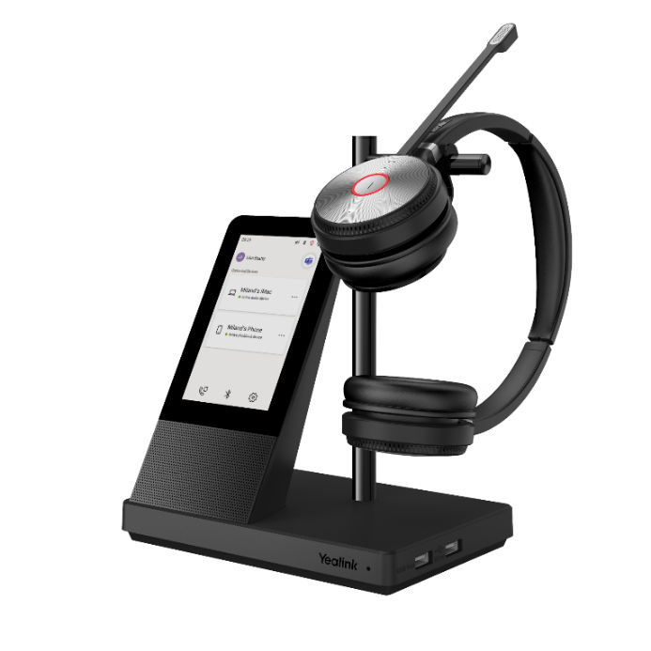
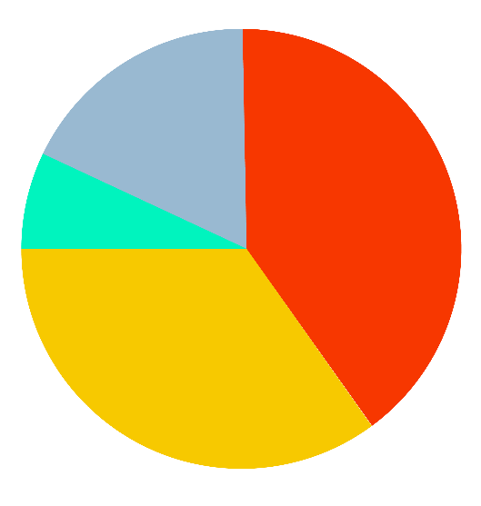
Why Yealink Headsets – Great Applause from Market
Others
18%
Yealink 7%
Poly
40%
Yealink
30%
Others
70%
Great Success in
WH6X DECT Headsets
Jabra
35%
2021
2025
For Yealink：
Successfully ranked among the industry's top headset manufacturers
For Yealink Distributor：
Expand sales product categories, provide more complete products and services, and improve customer stickiness
Expand sales channels and drive the rapid development of overall performance

Slide 7
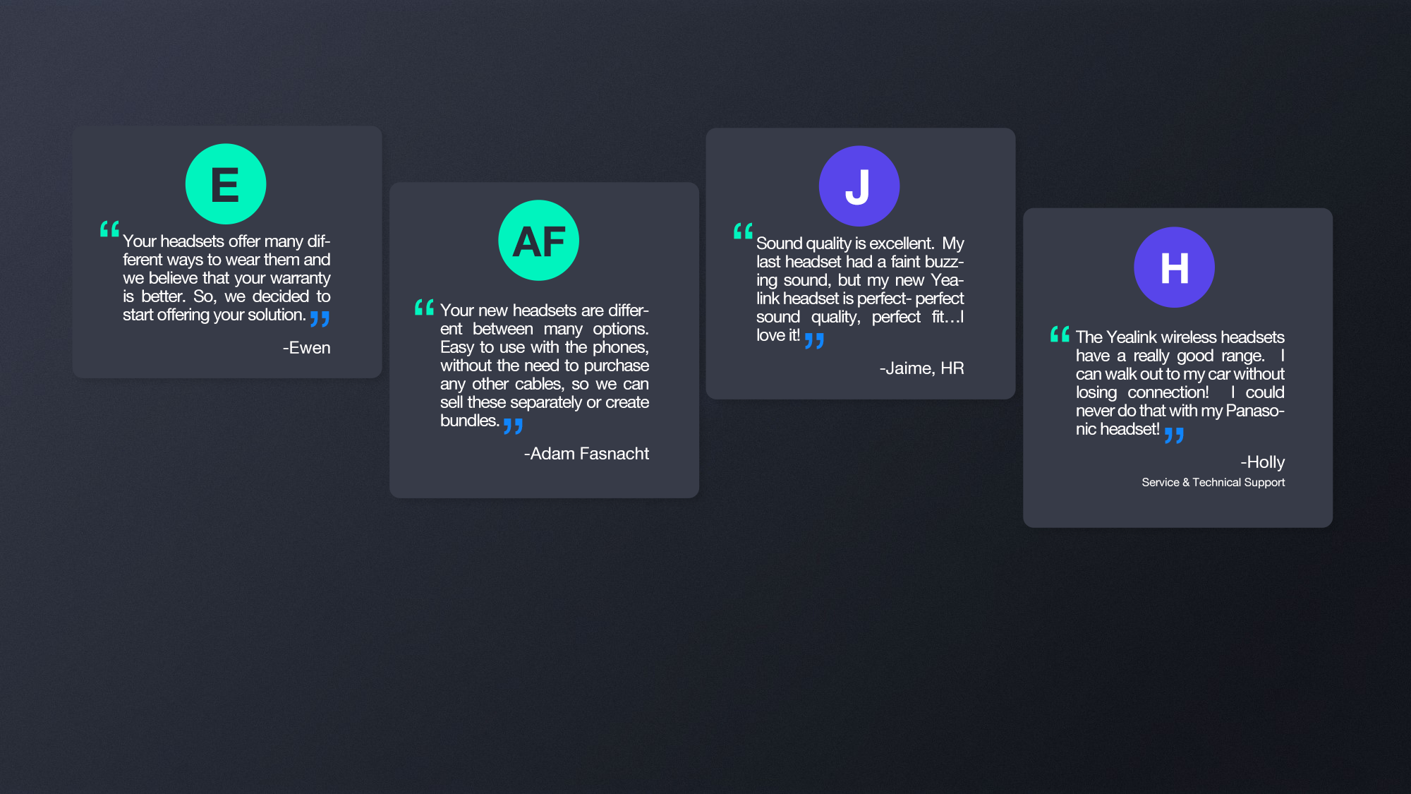
Why Yealink Headsets – Great Applause from Market

Slide 8
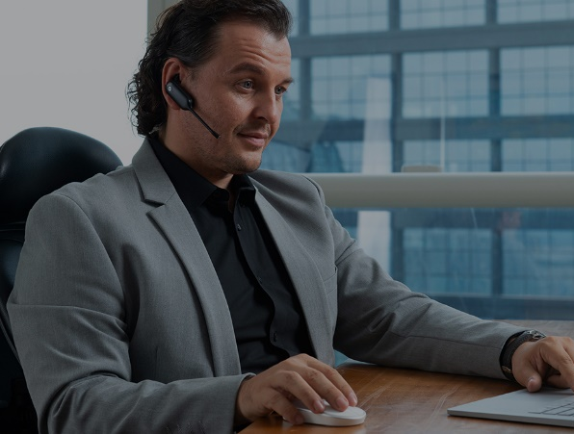
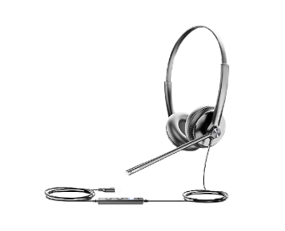
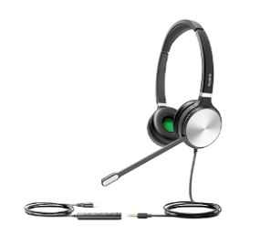
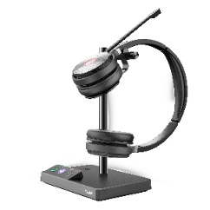
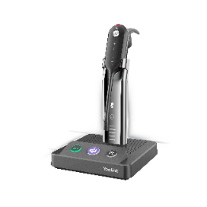
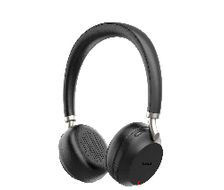
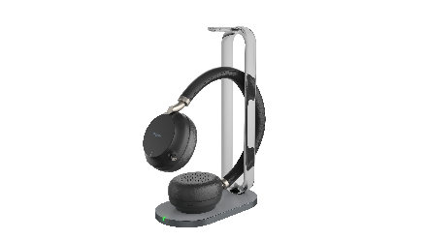
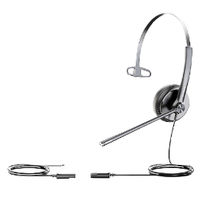
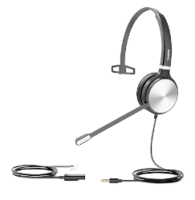
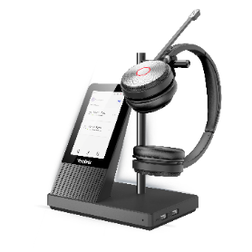
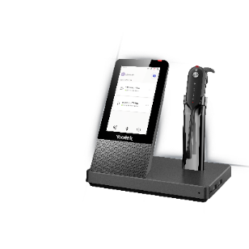
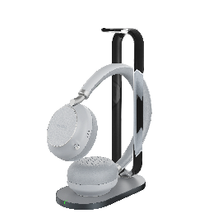
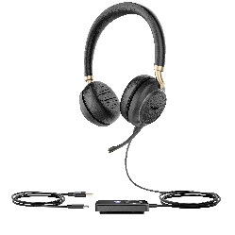
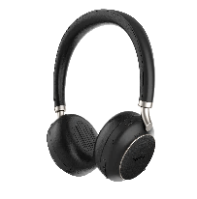
Why Yealink Headsets - Complete Headset Solutions
USB Wired Headsets
(Office/Call Centric/
Work from Home)
RJ/QD Wired Headsets
(Call Centric)
DECT Wireless Headsets
(Office/Call Centric/
Work from Home)
Bluetooth
Headset
（co-working spaces/ home office/private office/on the go ）
UH34/UH34 Lite
UH36
YHS34/YHS34 Lite
WH62
WH63
BH72 Lite Black/Gray
BH72 with Charging Stand
Black/Gray
New
UH38
YHS36
WH66
WH67
BH76
Black/Gray
BH76 with Charging Stand
Black/Gray

Slide 9
Bluetooth Headset BH72/BH76
ANYWHERE WORKPLACE

Slide 10
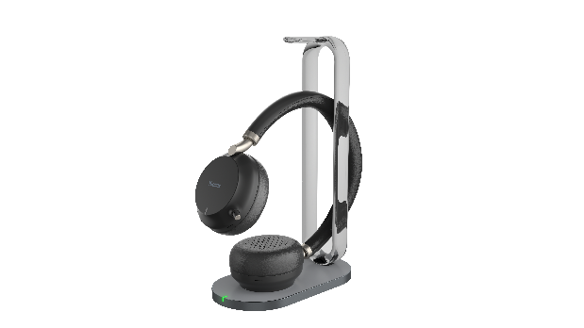
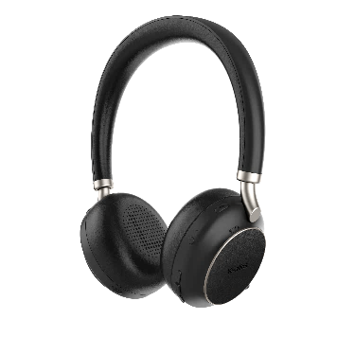
Yealink Bluetooth Wireless Headset
BH7 Series
Entry Level
The fashion and powerful Bluetooth Wireless headset series, ideal for co-working spaces, home office, private office, or on the go, is also suitable for people who use a mobile phone to work.
BH72 Lite Black/Gray
BH72 with Charging Stand
Black/Gray
Premium Level
BH76
Black/Gray
BH76 with Charging Stand
Black/Gray

Slide 11
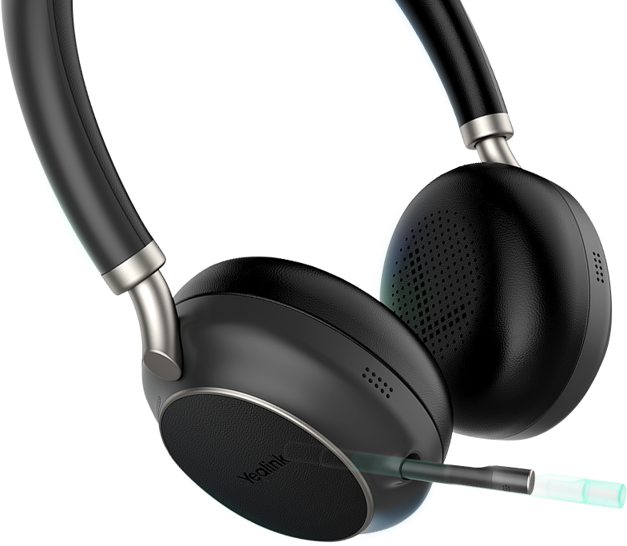
Retractable hidden microphone arm
Provide both business and consumer experience
Magnetic slide rail, gently push/pull, automatically retract/extend

Slide 12
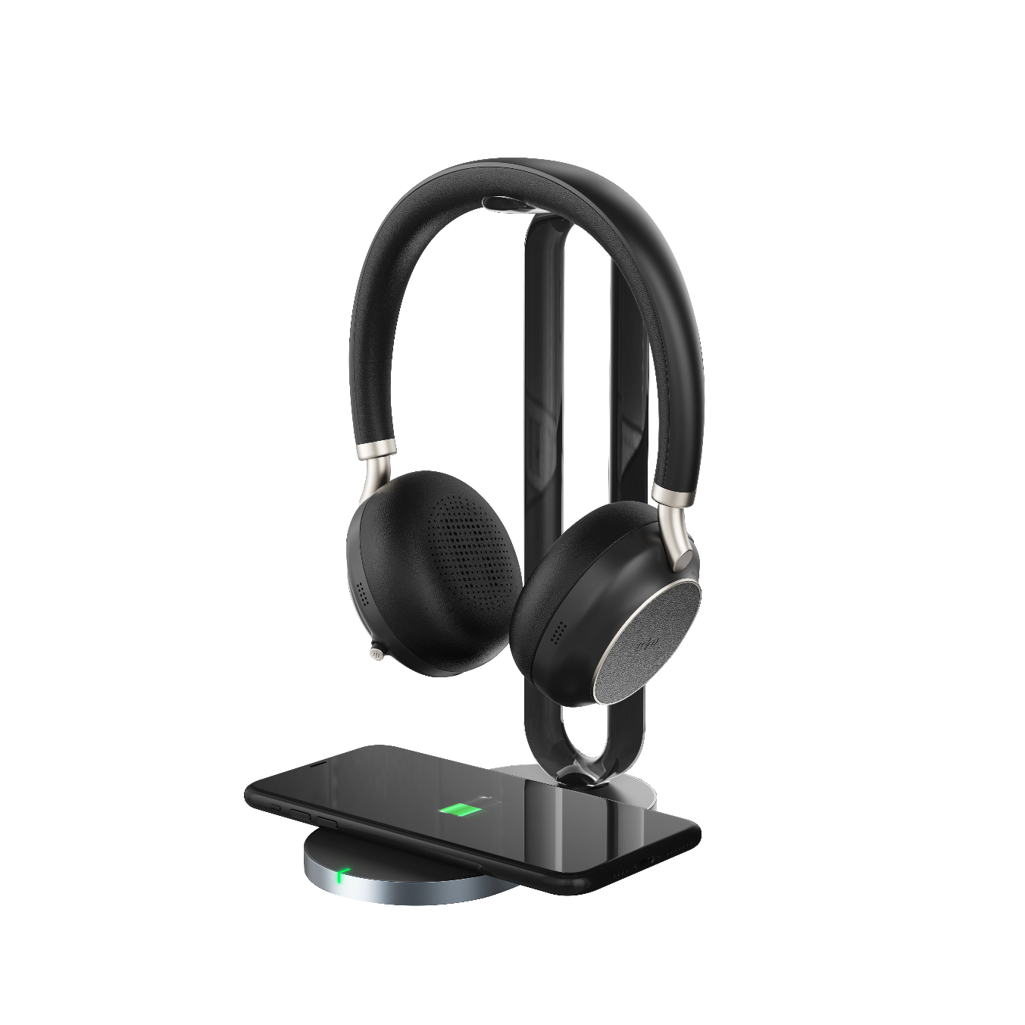
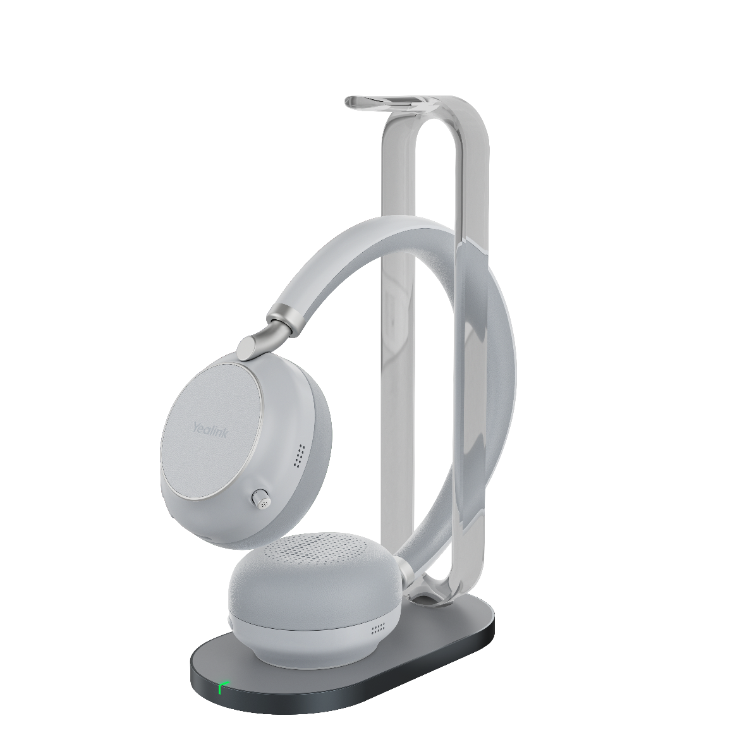
Multifunctional Wireless Charging Base & Long-Time Working
Improve productivity, keep workspace tidy and clean：
Wireless Charging for Headset and Smart phone
Work as headset hanger
Long Battery Life：
BH72/76 with 35/28 hours talking time to power up all day talking.

Slide 13
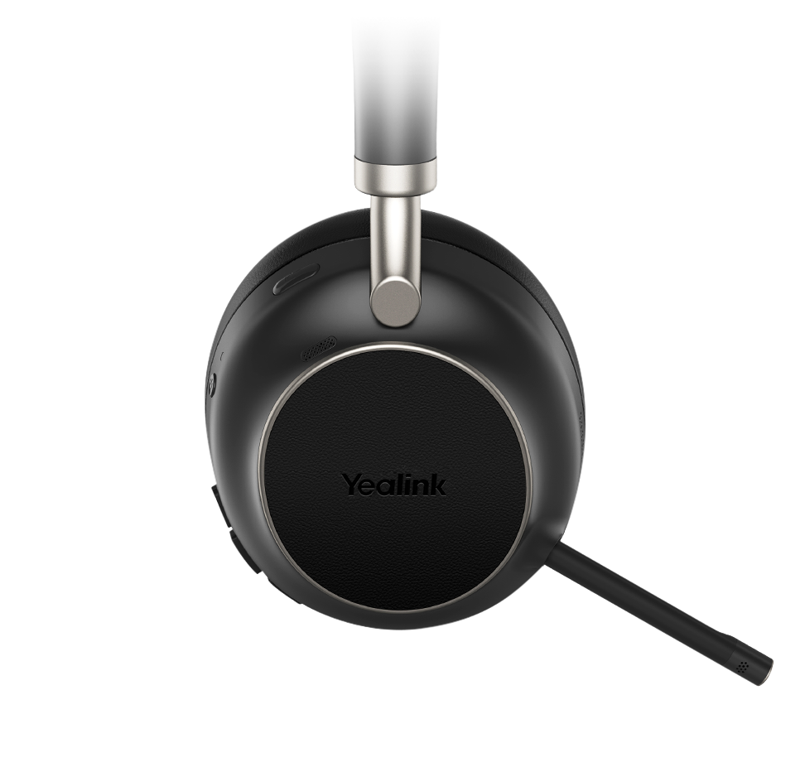
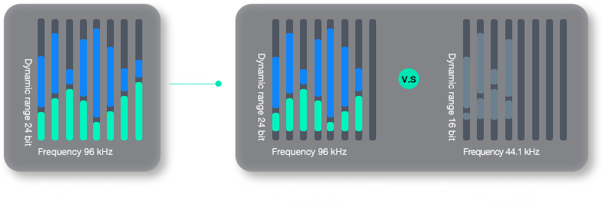
Hi-Fi Level Audio Codec aptX
Experience & play in the richest details
Adopted Hi-Fi level audio codec aptX delivers pure and delicate sound with less distortion, lower noise floor and intricate details of high-quality music.

Slide 14
Intelligent Dynamic ANC,
When you listen, listen in the best way
Intelligent dynamic ANC, including four modes(ANC level medium, ANC level high, Talk transparent, and Fully Transparent), brings customizable noise cancellation adjustment in different environments for a more suitable and comfortable active noise cancellation effect.

Slide 15
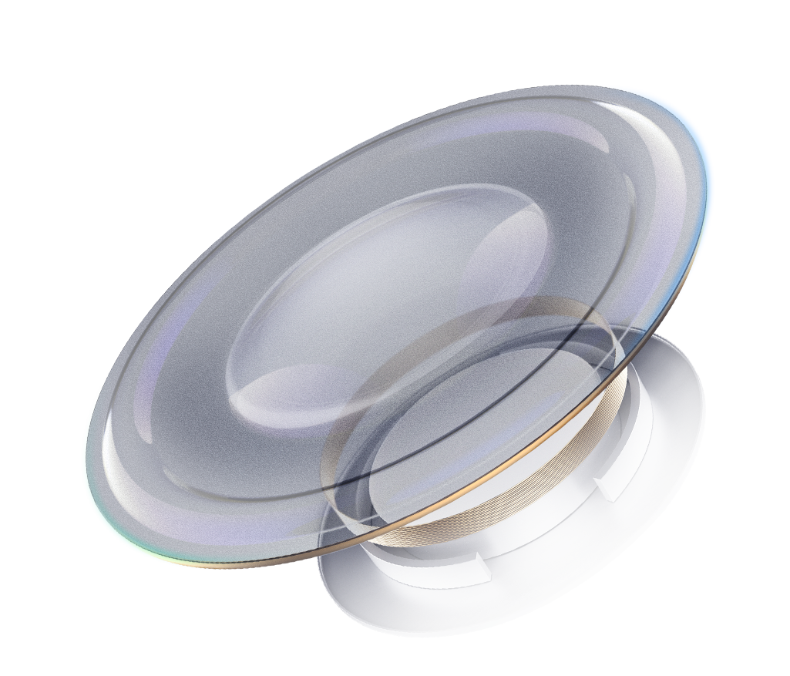
Other Highlights
Yealink Acoustic Shield Technology
Multiple Microphones
Hi-Fi Level Audio Codec AptX
The Ole Wolff diaphragm
Intelligent Dynamic ANC(4 levels)
Wearing Detection

Slide 16
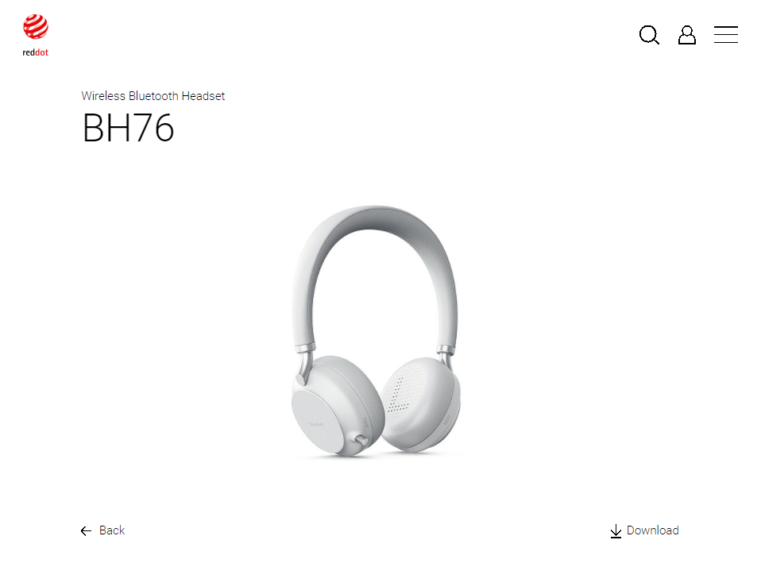
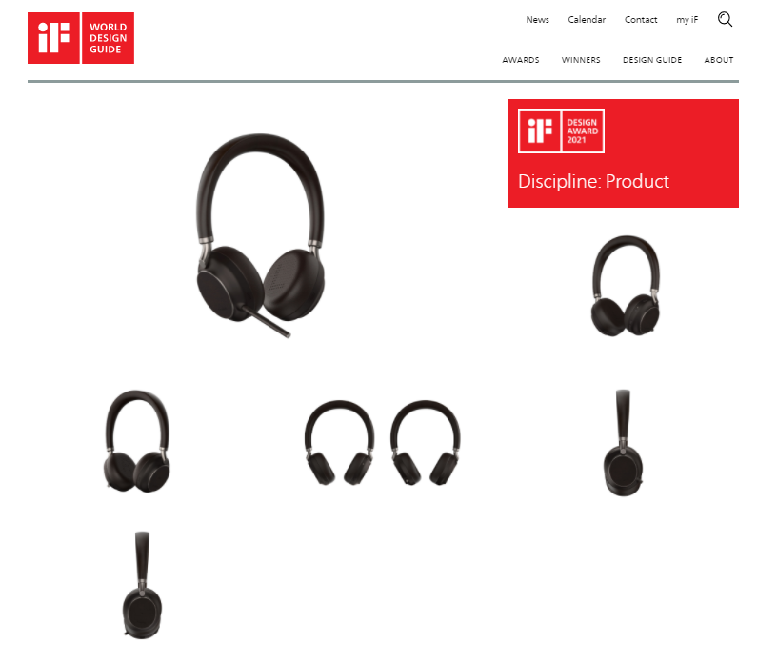
Awards

Slide 17
Bluetooth Wireless Headset benchmark-BH7X Series
 |  | BH76 | BH76
Color |  | Light Gray/Black | Light Gray/Black
Feature | Wearing Detection | √ | X
 | Dual Busylight on Headset | √ | √
 | Mic-boom Stretch for Mute/Answer | √ | √
 | Ear Cushions Easily Replacable | √ | √
Audio | Yealink Acoustic Shield | √ | √
 | Active Noise Cancellation （ANC） | √ | X
 | Microphone Number | 5 | 2
Battery | Talking time | up to 35 hours(ANC off) | up to 35 hours
 | Music time | up to 40 hours(ANC off) | up to 40 hours
 | Standby time | 112 hours | 112 hours
 | Charing Time (cable) | 2 hours | 2 hours
 | Charing Time (wireless charging) | 3 hours | 3 hours
Connectivity | Bluetooth version | Bluetooth 5.2 | Bluetooth 5.2
 | Operating range | Up to 30m/Up to 100ft | Up to 30m/Up to 100ft
 | Bluetooth pairing lis | Up to 8 devices | Up to 8 devices
 | Simultaneous Bluetooth connections | 2 | 2
Management | Yealink USB Connect（PC） | √ | √
 | Yealink Connect APP | √ | √
 | Yealink Device Management Platform | √ | √
Product Weight |  | 201g (BH76) 527g (BH76 with Charging Stand) 326g (BHC76) | 187g (BH72 Lite) 189g (BH72) 515g (BH76 with Charging Stand) 326g (BHC76)

Slide 18
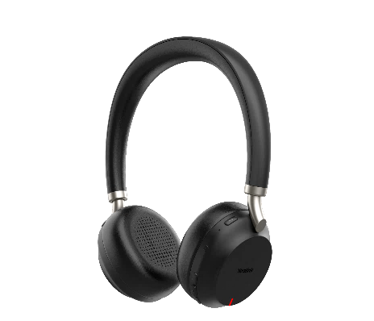
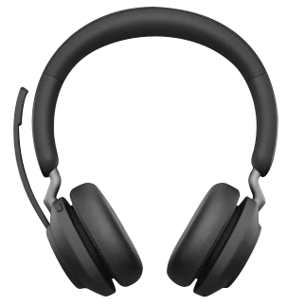
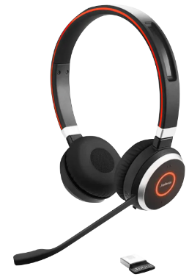
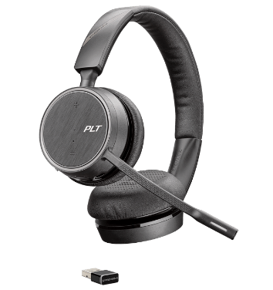
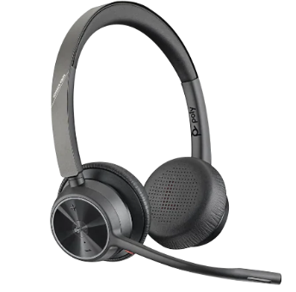
Bluetooth Wireless Headset benchmark-BH72
 | BH72 | Jabra Evolve2 65 | Jabra Evolve 65 | Poly Voyager 4200 | Poly Voyager 4300
Headset Style | On-ear | On-ear | On-ear | On-ear | On-ear
Discrete Hidden Boom Arm | √ | x | x | x | x
Microphone | 2 | 2 | 1 | 1 | 2
Busylight | Dual side | Dual side | Single side | x | Single side
Talking Time (up to) | 35h | 35h | 14h | 12h | 24h
Bluetooth | 5.2 | 5.0 | 4.2 | 5.0 | 5.2
Wireless Charging | Optional | x | x | x | x

Slide 19
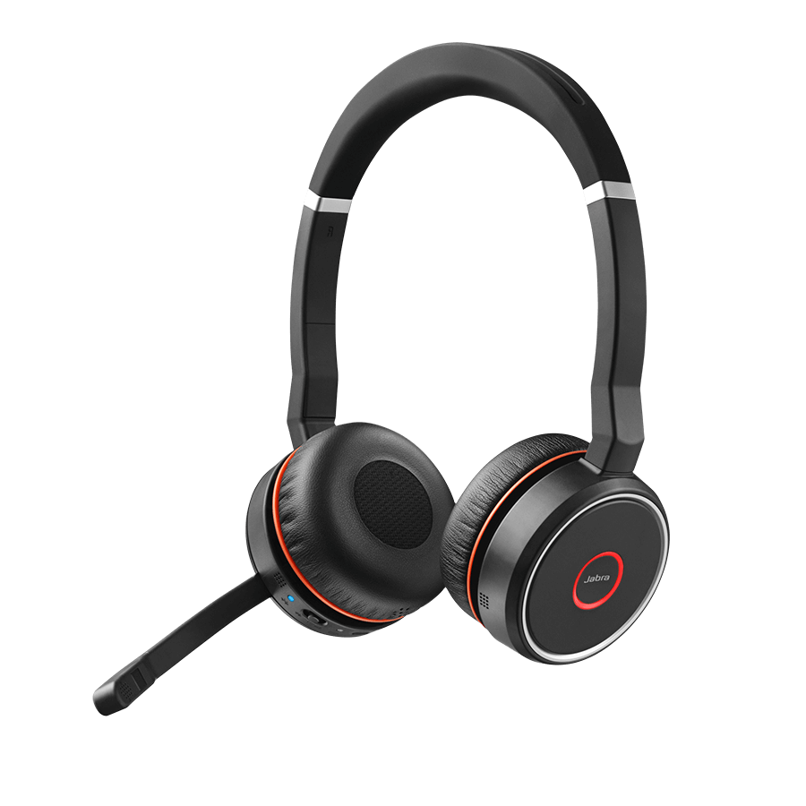
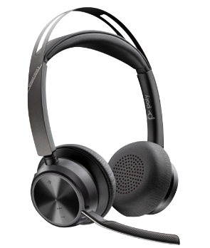
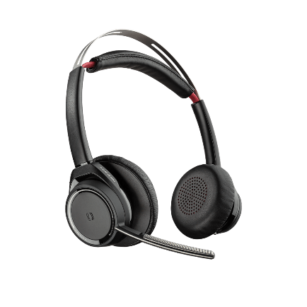
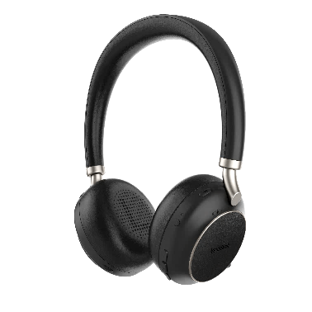
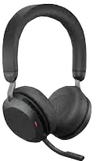
Bluetooth Wireless Headset benchmark
 | BH76 | Jabra Evolve2 75 | Jabra Evolve 75 | Poly Voyager Focus2 | Poly Voyager Focus
Headset Style | On-ear | On-ear | On-ear | On-ear | On-ear
Discrete Hidden Boom Arm | √ | √ | x | x | x
ANC | √ | √ | √ | √ | √
Controllable Noise Cancelling | 4 Levels | 2 Levels | X | 2 levels | 2 levels
Microphone | 5 | 8 | 1 | 4 | 4
Busylight | √ | √ | √ | √ | x
Talking Time (up to) | 35h | 24h | 18h | 19h | 12h
Codec | AtpX, AAC, SBC | AAC,SBC | SBC | AtpX, SBC
Bluetooth | 5.2 | 5.2 | 4.2 | 5.1 | 4.1
Wireless Charging | √ | x | x | x | x

Slide 20
WH6 DECT Wireless Headset Series
Redefine Your Workspace

Slide 21
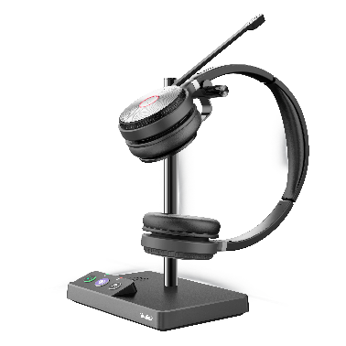
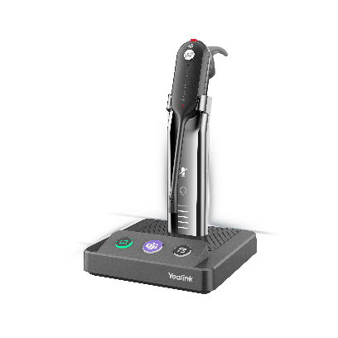
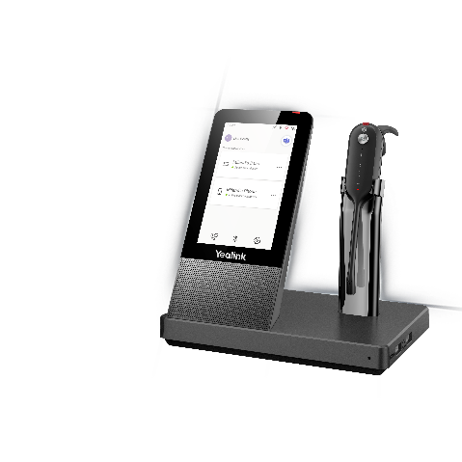
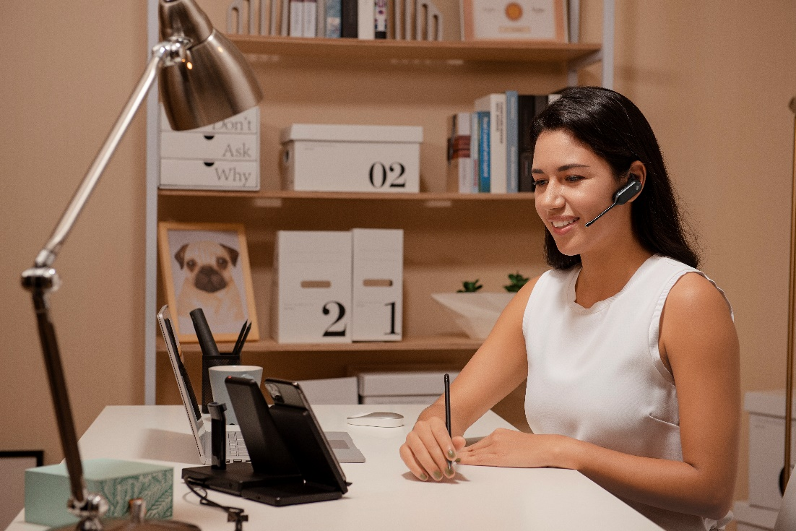
Yealink DECT Wireless Headset
WH6 Series
WH62 Dual/Mono
WH63 Convertible
The simple and powerful DECT Wireless headset series, ideal for
co-working spaces, home office or private office
WH66 Dual/Mono
WH67 Convertible

Slide 22
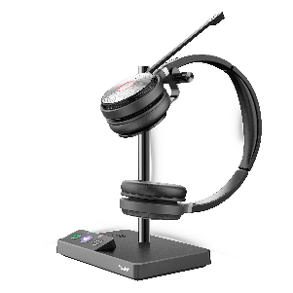
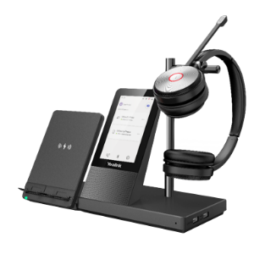
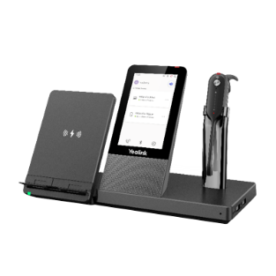
Recommended User Scenarios
Open Office/ Call Center
Key consideration: Background noise, Interruptions, Instant connection, Freedom to move around.
· Dual microphones with Yealink Acoustic Shield technology for
noise cancellation
· Busylight helps to reduce distractions and eliminate interruptions
· Dual USB connection to PCs and Phone simultaneously
· Up to 160 meters’ mobile range and 14 hours’ talk time
WH62
WH63
Home Office/ Private Office/ Hot Desking
Key consideration: Simplified workspace, Flexible conversations, Quick switch between calls
· All-in-one professional communication device to minimize the
number of tools and wires
· Easily manage calls and devices on the 4-inch touch console
· Full-duplex Hands-free Speakerphone with AEC
· Optional Qi wireless mobile phone charging stand
WH66
WH67

Slide 23
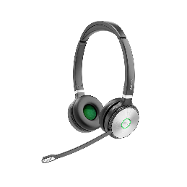
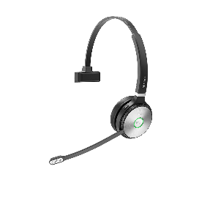
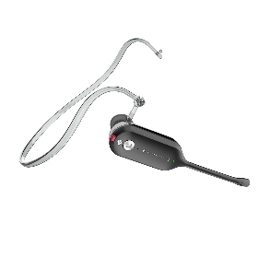
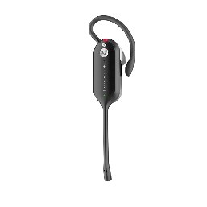
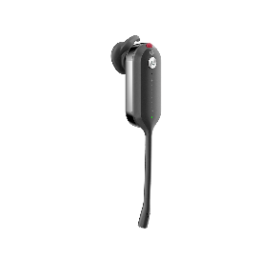
Ergonomic Design
for All-day Wearing Comfort
Dual/Mono For WH62 & WH66
Convertible For WH63 & WH67
Breathable Wearing
Lightweight Design
Soft Leather Ear Cushions (WH62 & WH66)
330° Adjustable Microphone (WH62 & WH66)

Slide 24
Noise-Canceling Microphone
for Superior calling experience
2X
Microphones
HD Voice Quality | Yealink Acoustic Shield Technology | Dual Microphones

Slide 25
Long Wireless Range & All Day Power
for More Working Flexibility
Enable to move around the office without losing their call
Long Wireless Range
for up to 160m
All Day Power
for up to 14 hours talk time
High Density Installation
for up to 200 users (EU)

Slide 26
Seamless Compatibility
for Consistent Calling Experience
Broad Compatibility with mainstream UC Applications
Teams version available for the unified Teams experience
Connecting Yealink phones without EHS
Supports USB connection for Plug-and-Play
UC or Teams edition

Slide 27
Busylight helps to reduce distractions and eliminate interruptions
Integrated Busylight
Customizable
Synchronously present working state
Busylight Peripheral
Customizable
Plug-and-Play
Synchronously present working state

Slide 28
WH66 & WH67

Slide 29
WH66 & WH67
for More Working Possibilities
All Devices in One
Combines a full-duplex speakerphone, USB hub, wireless charging stand and control pad.
All Connections in One
Built-in Bluetooth and USB connection allow the connectivity of 3 devices simultaneously.
All Controls in One
Realize devices connection, calls control, change settings with one touch.

Slide 30
All-in-One
Keep your workspace
tidy and clean
Wireless Mobile Phone Charging Stand
4-inch Touch Console
Full-duplex Speakerphone with AEC
Noise-canceling Technology
USB + Bluetooth Connection
2 Ports USB Hub
Busylight Peripheral

Slide 31
Control all Meetings and Calls through One Touch
Connect up to 3 devices simultaneously via USB or Bluetooth
One touch to activate Teams app, make/receive calls through different devices or platforms
Call control – dial a call, join a meeting, call merge, mute, hold, etc.
Customize personal settings
Choose your preferred way to have a call through headset or speakerphone.
…

Slide 32
WH6 DECT Wireless Headset Series
 |  |  | WH62 Mono/Dual | WH63 | WH66 Mono/Dual | WH67
Headset | Headset Wearing Style |  | Over-the-head | Convertible | Over-the-head | Convertible
 | Audio | Microphone | 2x | 2x | 2x | 2x
 |  | Yealink Acoustic Shield | √ | √ | √ | √
 |  | Wideband (Taking Mode)* | √ | √ | √ | √
 |  | Super Wideband (Music Mode) | √ | √ | √ | √
 | Features | Busylight on Headset | √ | √ | √ | √
 |  | Mic-boom lift for Mute | √ | x | √ | x
 |  | Ear Cushions Easily Replaceable | √ | √ | √ | √
 | Range | DECT Wireless Range – up to m | 160 | 120 | 160 | 120
 | Battery | Talking Time – up to hours | Mono:13/Dual:14 | 8 | Mono:13/Dual:14 | 8
 |  | Standby Time – up to hours | Mono:90/Dual:125 | 54 | Mono:90/Dual:125 | 54
Base | Features | 4-inch IPS Touch Screen | x | x | √ | √
 |  | Built-in USB 3.0 Hub | x | x | 2x | 2x
 |  | Speakerphone Mode | x | x | √ | √
 |  | Ringer | √ | √ | √ | √
 | Connectivity | USB Input Connections | 2x Micro USB | 2x Micro USB | 1x USB 3.0 | 1x USB 3.0
 |  | Bluetooth Connections | x | x | 2x | 2x
 | Accessories | Busylight (2.5mm port) | Optional | Optional | Optional | Optional
 |  | Qi Wireless Charging Stand | x | x | Optional | Optional
*Available in mid-2021

Slide 33
DECT Wireless Headset benchmark
 |  | WH62 | WH63 | Jabra Pro 930/920 | Jabra Engage 65 | Poly CS540
Headset | Headset | Dual/Mono | Convertible | Dual/Mono | Dual/Mono/Convertible | Convertible
 | Microphone | 2x | 2x | 1 | 2x | 1
 | Busylight | √ | √ |  | √
 | Talking Time (up to) | Mono:13h/Dual:14h | 7h | 8h | 13h/9h | 7h
 | Range (up to) | 160m/525ft | 120m/394ft | 120m/395ft | 150m/490ft | 100m/330ft
DECT Base | Connection | 2x USB | 2x USB | 1x USB (930) or 1x RJ (920) | USB, RJ | RJ
 | Ringer | √ | √
(Optional) Accessories | Busylight | √ | √ |  | √

Slide 34
DECT Wireless Headset benchmark
 |  | WH66 | WH67 | Jabra Engage 75 | Poly Savi 8220
Headset | Headset | Dual/Mono | Convertible | Dual/Mono/Convertible | Dual/Mono, Convertible
 | Microphone | 2x | 2x | 2x | 1
 | Busylight | √ | √ | √
 | ANC |  |  |  | √
 | Talking Time (up to) | Mono:13h/Dual:14h | 8h | 13h/9h | 13h
 | Range (up to) | 160m/525ft | 120m/394ft | 150m/490ft | 180m/590ft
DECT Base | Connection | USB, 2x Bluetooth | USB, 2x Bluetooth | 2x USB, RJ, 2x Bluetooth | USB, RJ, Bluetooth
 | Touch screen | 4-inch IPS Touch Screen | 4-inch IPS Touch Screen
 | Hand-free Speaker | √ | √
 | USB 3.0 Hub | √ (2x) | √ (2x)
(Optional) Accessories | Busylight | √ | √
 | Wireless Charger | √ | √

Slide 35
UH38 & UH36 & UH34
USB Wired Headset Series

Slide 36
Yealink USB Headsets
Unified Communication USB Cored Headset. A peripheral mainly used in office room for calls and music.
Call Center
Office Room
Remote Worker

Slide 37
UH38 Premium USB Wired Headset
ONE HEADSET, DUAL CONNECTION

Slide 38
Premium USB Wired Headset UH38
The demand for work with dual devices are more and more
Add the Bluetooth feature into the USB wired headset
Get a Bluetooth experience without increasing costs while using USB headsets

Slide 39
UH38
Unified Communication USB Cored Headset. A peripheral is mainly used in the office room for calls and music.
PC and Mobile Phone Dual Connections

Slide 40
UH38
 | UH38 | Jabra Evolve2 40
Headband | Leather wrapped/sponge lining | Silicone wrap/no sponge lining
Bluetooth | BT 5.1 | ×
Battery capacity | 200mAh | ×
Talk Time | Up to 7h | ×
Controller Unit | √ | ×
Busylight | Dual Side | Dual Side
Lift Mic-Boom to Mute | √ | √
Speaker Frequency | 20Hz~20KHz | 20Hz~20KHz
Mic Frequency | 100Hz~14KHz | 100Hz~14KHz

Slide 41
UH36 & UH34 Classic USB Wired Headset
Stable Audio, Flexible Connection

Slide 42
Simple and Flexible Connectivity
UH36
UH34
Designed for Unified Communication, UH36 comes with USB and 3.5mm jack connectivity options, free to plug into various devices: IP phone, PC, tablet, and smart phone.
UH34/UH34 Lite comes only with USB connectivity.

Slide 43
Native Integration and Easy Management
Basic functions
. Answer / End
. Call mute
Enhanced functions integrated
With Yealink IP phone
(V85 and above)
. Audio optimization
. Redial
. Call hold
. Volume synchronization
. Multiple calls control
Perfect match for Yealink IP Phone, give you optimized audio quality and more enhanced functions.
Proven reliability and integrations for Yealink USB Connect Software, Yealink Device Management Platform/Cloud Service, easy to manage the device.

Slide 44
Excellent Audio Performance
Unparalleled audio
experience
Noise-canceling
microphone
Yealink Dynamic EQ and Wideband HD Audio Technology make every conversation rich and clear. The passive noise cancellation and the noise-canceling microphone eliminate background noise, enhance the audio privacy.

Slide 45
All Day Wearing Comfort
Breathable
wearing
Lightweight
design
Easy to replace
the cushions
UH36
(Leather ear cushion)
UH34
(Leather ear cushion)
UH34 Lite
(Foamy ear cushion)
The ergonomic and lightweight design makes UH36/UH34/UH34 Lite comfortable enough for long conference calls and all day use.

Slide 46
UH USB Wired Headset Series
Model | UH34&UH34 Lite Mono / Dual | UH36 Mono / UH36 Dual
Supported operating systems | Microsoft Windows®, Apple Mac OS | Mcrosoft Windows®, Apple Mac OS
Microphone type | MEMS Uni-Directional Microphone | MEMS Uni-Directional Microphone
Wideband(Talk Mode) | Yes | Yes
Headset Wearing Style | On-the-ear | On-the-ear
Easy Replacement Ear Cushions | Yes | Yes
Teams Certificated | Yes | Yes
Yealink IP Phone Integration | Yes | Yes
Call control feature | Answer/End a call Volume up/down Microphone mute Redial last outgoing call Reject incoming call | Answer/End a call Volume up/down Microphone mute Redial last outgoing call Reject incoming call
Headset cable length | 1.2m (from headset to 3.5 mm jack) | 1.2m (from headset to 3.5 mm jack)
USB/QD to RJ cable length | 0.9m(from call control unit to USB plug) | 0.9m(from call control unit to USB plug)
Cable length in total | 2.1m | 2.1m
Connection | 3.5 mm jack ，USB 2.0 | 3.5 mm jack ，USB 2.0
Weight | UH34 Mono：88g UH34 Dual：118g UH34 Lite Mono：84g UH34 Lite Dual：110g | UH36 Mono：120g UH36 Dual：155g

Slide 47
Comparison Table of Yealink USB Wired Headsets
Model | Yealink UH34 Lite | Jabra Evolve 20 | Poly Blackwire 3210/3220 | Poly Blackwire 3310/3320
List Price | Mono: $43 | Mono: $47 | Mono: $45 | Mono:$49.95
 | Dual: $47 | Stereo: $52 | Stereo: $50 | Stereo: $54.95
Ear Cushions Type | Foam | Foam | Foam | Foam
Ear Cushions Easily Replaceable | √ | √ | X | X
Noise Canceling Microphone | √ | √ | √ | √
Wideband Audio | Dynamic EQ | 150Hz~7kHz | Dynamic EQ | Dynamic EQ
 | 20 Hz-20 kHz |  | 100 Hz-10kHz | 20 Hz-20 kHz
MS Teams Button | √ | X | X | √
Microphone Boom | 330° | 300° | 270° | 270°
Yealink Device Management | √ | X | X | X
Weight | 75 g | 142.5 g | 87 g | 102g
 | 112 g | 171.1 g | 118 g | 130g

Slide 48
Comparison Table of Yealink USB Wired Headsets
Model | Yealink UH34 | Jabra Evolve 30 | Poly Blackwire 3215/3225 | Poly Blackwire 3315/3325
List Price | Mono: $49 | Mono: $78 | Mono: $75 | Mono:$79.95
 | Dual: $59 | Stereo: $83 | Stereo: $80 | Stereo:$84.95
Ear Cushions Type | leatherette | leatherette | leatherette | leatherette
Ear Cushions Easily Replaceable | √ | X | X | X
Noise Canceling Microphone | √ | √ | √ | √
3.5mm Jack | X | √ | √ | √
Wideband Audio | Dynamic EQ | 150Hz~7kHz | Dynamic EQ | Dynamic EQ
 | 20 Hz-20 kHz |  | 100 Hz-10kHz | 20 Hz-20 kHz
MS Teams Button | √ | X | X | √
Microphone Boom | 330° | 300° | 270° | 270°
Yealink Device Management | √ | X | X | X
Weight | 82.5g | 142.5 g | 96 g | 102g
 | 118g | 171.1 g | 121 g | 130g

Slide 49
Comparison Table of Yealink USB Wired Headsets
Model | Yealink UH36 | Jabra Evolve 40 | Poly Blackwire 5200
List Price | Mono: $74 | Mono: $95 | 5210: $100
 | Dual: $89 | Stereo: $109 | 5220: $110
Ear Cushions Type | leatherette | leatherette | leatherette
Ear Cushions Easily Replaceable | √ | X | X
Noise Canceling Microphone | √ | √ | √
3.5mm Jack | √ | √ | √
Wideband Audio | Dynamic EQ | 20 Hz – 20 kHz | Dynamic EQ
 | 20 Hz-20 kHz |  | 100Hz to 20 kHz
Busylight | X | √
MS Teams Button | √ | X | X
Microphone Boom | 330° | 270° | 270°
Yealink Device Management | Advanced | X | X
Weight | 120 g | 142.5 g | 125.4 g
 | 155 g | 171.1 g | 164.2 g

Slide 50
YHS36 & YHS34 & YHS34 Lite
QJ to RJ Wired Headset Series

Slide 51
Perfectly Compatible with Yealink Phones
Runs right out of the box, a QD (Quick Disconnect) to RJ9 plug-and-play setup ensures the connectivity to Yealink Desk phones. Perfect match with Yealink desk phones give you optimized audio quality and more enhanced functions.

Slide 52
Noise-Canceling Microphone—YHS36
Excellent Audio Experience
The noise-canceling microphone allows for the most reduction of outside noise, so the listeners can focus more on the desired sound at hand, the nearby talkers are protected with most call privacy as well..

Slide 53
Ultra Lightweight Design—YHS34&YHS34 Lite
Built for comfort with soft ear cushions and ultra-lightweight materials, the YHS34/ YHS34 Lite is 10%~30% lighter than other headsets in the same range. The extremely lightweight design enables all-day wearing comfortable without pressure.

Slide 54
All Day Wearing Comfort
YHS36
(Leather ear cushion)
YHS34
(Leather ear cushion)
YHS34 Lite
(Foamy ear cushion)
The over-the-head wearing style, ultra-lightweight materials, and bio-mimetic protein-based leather ear cushions make your head and ears feel relaxed. Its ergonomic design enables the YHS36/YHS34/YHS34 Lite comfortable enough for long conference calls and all day use.

Slide 55
YHS USB Wired Headset Series
Model | YHS34&YHS34 Lite Mono / Dual | YHS36 Mono / Dual
Microphone type | MEMS Uni-Directional Microphone | MEMS Uni-Directional Microphone
Wideband(Talk Mode) | Yes | Yes
Headset Wearing Style | On-the-ear | On-the-ear
Easy Replacement Ear Cushions | Yes | Yes
Yealink IP Phone Integration | Yes | Yes
Headset cable length | 1.2m (from headset to QD jack) | 1.3m (from headset to QD jack)
USB/QD to RJ cable length | 0.9m(QD to RJ cable) | 0.10m(QD to RJ cable)
Cable length in total | 2.1m | 2.1m
Connection | QD to RJ | QD to RJ
Weight | YHS34 Mono：72g YHS34 Dual：106g YHS34 Mono：68g YHS34 Dual：98g | YHS36 Mono：124g YHS36 Dual：170g

Slide 56
Thanks!

